Slide 1

4.2
Area
Copyright © Cengage Learning. All rights reserved.

Slide 2
Objectives
Use sigma notation to write and evaluate a sum.
Understand the concept of area.
Approximate the area of a plane region.
Find the area of a plane region using limits.

Slide 3
Sigma Notation

Slide 4

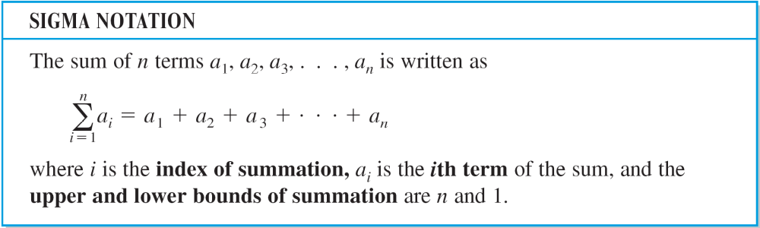
Sigma Notation
This section begins by introducing a concise notation for sums. This notation is called sigma notation because it uses the uppercase Greek letter sigma, written as

Slide 5
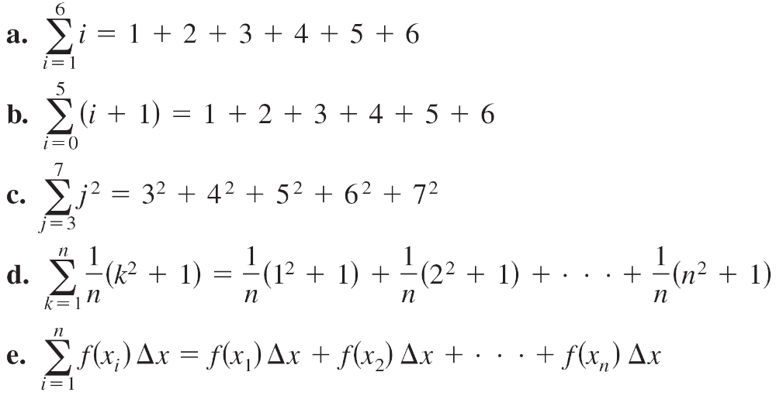
Example 1 – Examples of Sigma Notation
From parts (a) and (b), notice that the same sum can be represented in different ways using sigma notation.

Slide 6
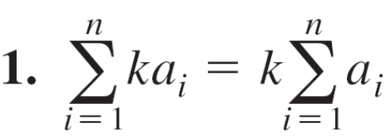
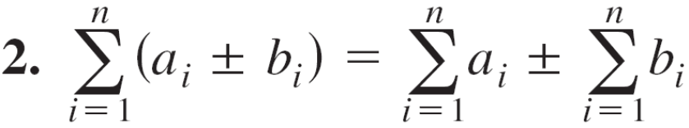
Sigma Notation
The following properties of summation can be derived using the associative and commutative properties of addition and the distributive property of addition over multiplication. (In the first property, k is a constant.)

Slide 7
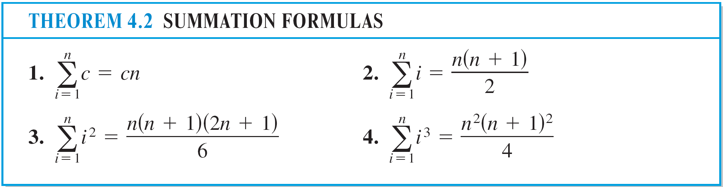
Sigma Notation

Slide 8
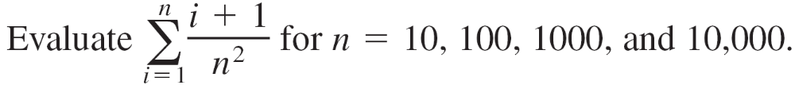
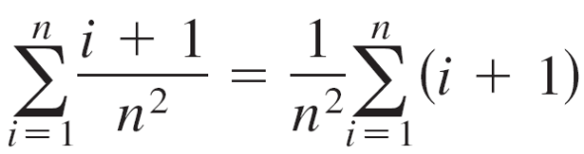
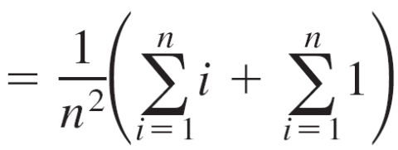

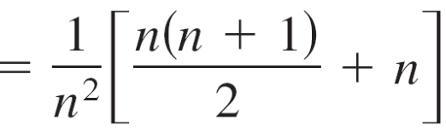

Example 2 – Evaluating a Sum
Solution:
Applying Theorem 4.2, you can write

Slide 9
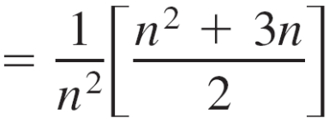

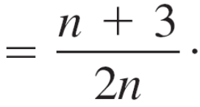
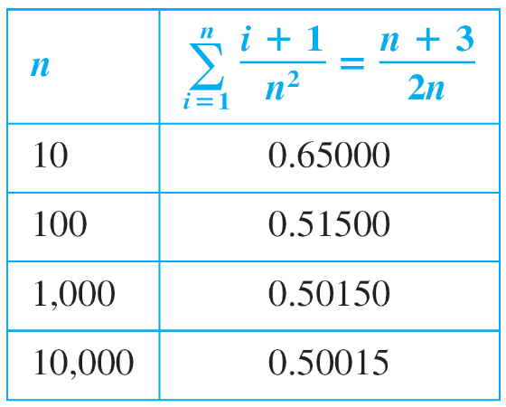
Example 2 – Solution
cont’d
Now you can evaluate the sum by substituting the appropriate values of n, as shown in the table.

Slide 10
Area

Slide 11
Area
In Euclidean geometry, the simplest type of plane region is a rectangle. Although people often say that the formula for the area of a rectangle is A = bh, it is actually more proper to say that this is the definition of the area of a rectangle.
From this definition, you can develop formulas for the areas of many other plane regions.

Slide 12
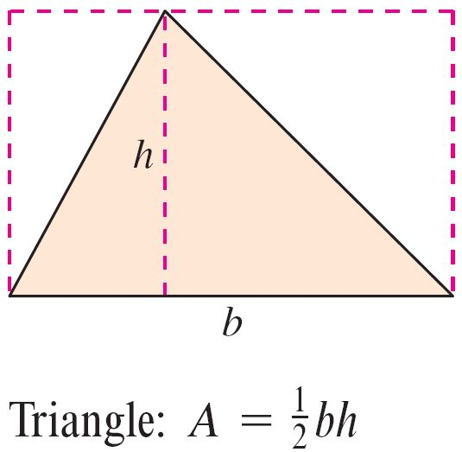
Area
For example, to determine the area of a triangle, you can form a rectangle whose area is twice that of the triangle, as shown in Figure 4.5.
Figure 4.5

Slide 13
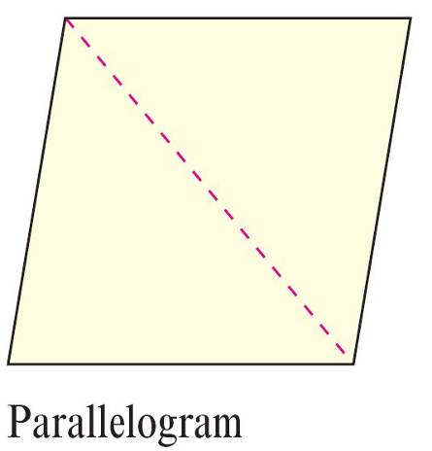
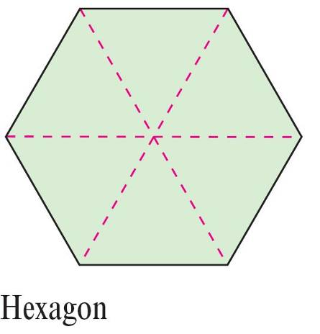
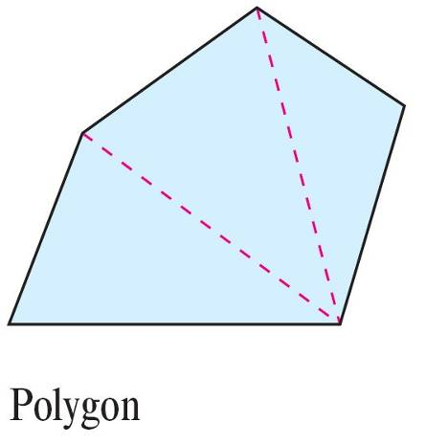
Area
Once you know how to find the area of a triangle, you can determine the area of any polygon by subdividing the polygon into triangular regions, as shown in Figure 4.6.
Figure 4.6

Slide 14
Area
Finding the areas of regions other than polygons is more difficult. The ancient Greeks were able to determine formulas for the areas of some general regions (principally those bounded by conics) by the exhaustion method.
The clearest description of this method was given by Archimedes. Essentially, the method is a limiting process in which the area is squeezed between two polygons—one inscribed in the region and one circumscribed about the region.

Slide 15
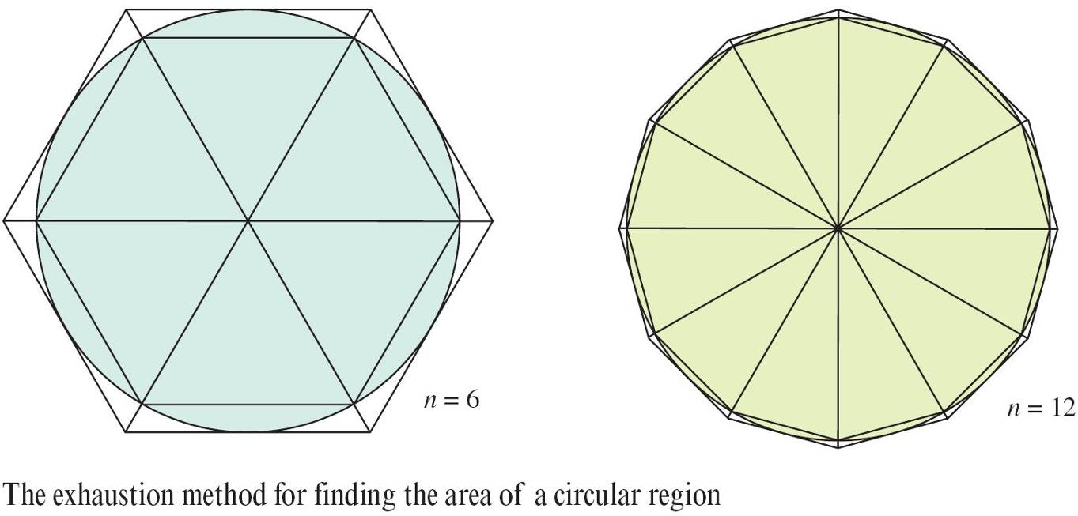
Area
For instance, in Figure 4.7 the area of a circular region is approximated by an n-sided inscribed polygon and an n-sided circumscribed polygon.
Figure 4.7

Slide 16
Area
For each value of n, the area of the inscribed polygon is less than the area of the circle, and the area of the circumscribed polygon is greater than the area of the circle.
Moreover, as n increases, the areas of both polygons become better and better approximations of the area of the circle.

Slide 17
The Area of a Plane Region

Slide 18
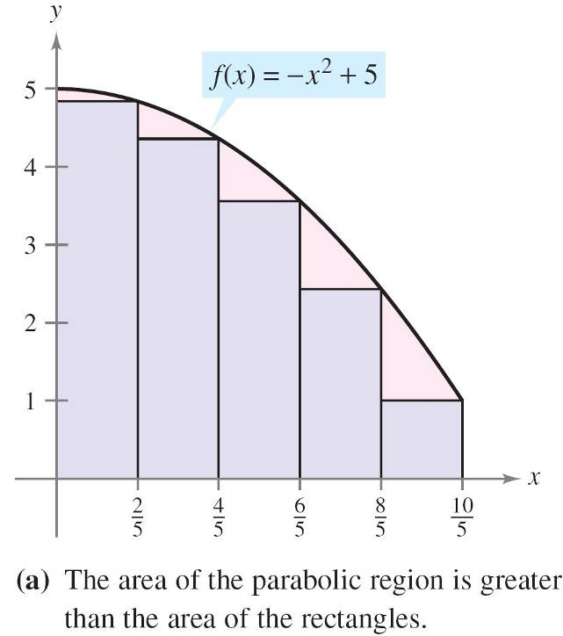
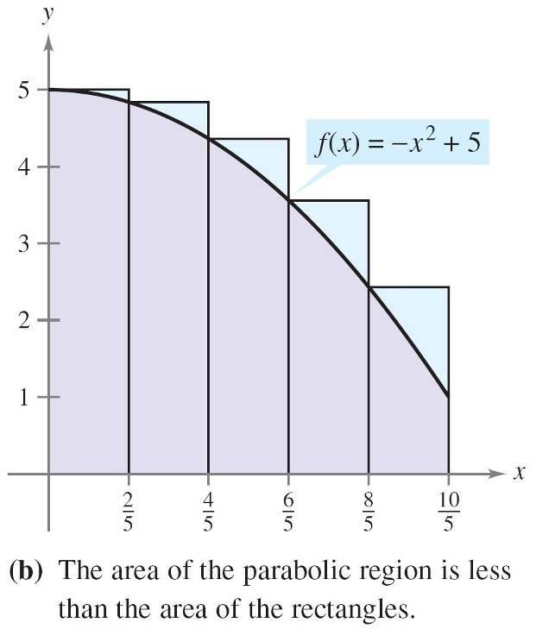
Example 3 – Approximating the Area of a Plane Region
Use the five rectangles in Figure 4.8(a) and (b) to find two approximations of the area of the region lying between the graph of f(x) = –x² + 5 and the x-axis between x = 0 and x = 2.
Figure 4.8

Slide 19


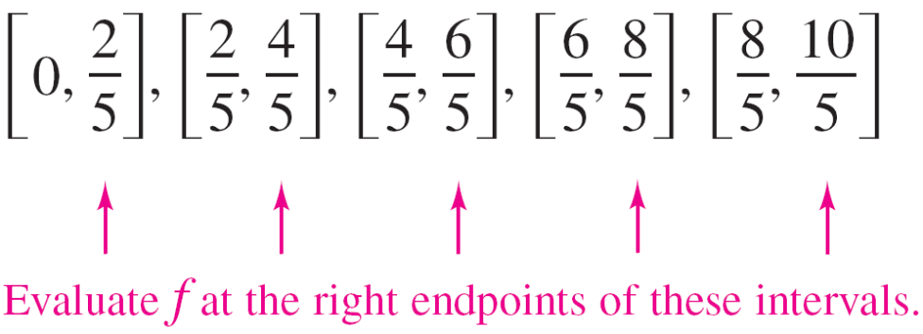
Example 3(a) – Solution
The right endpoints of the five intervals are ,
where i = 1, 2, 3, 4, 5.
The width of each rectangle is , and the height of each
rectangle can be obtained by evaluating f at the right endpoint of each interval.

Slide 20
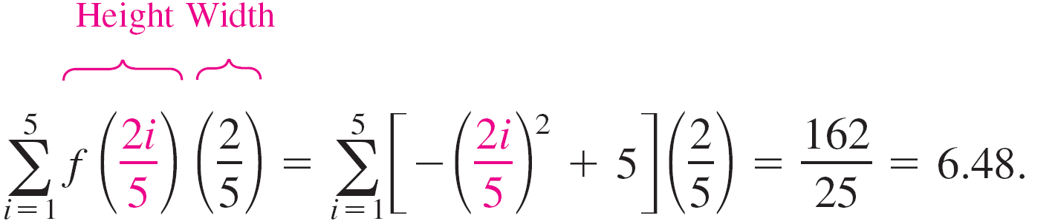
Example 3(a) – Solution
cont’d
The sum of the areas of the five rectangles is
Because each of the five rectangles lies inside the parabolic region, you can conclude that the area of the parabolic region is greater than 6.48.

Slide 21
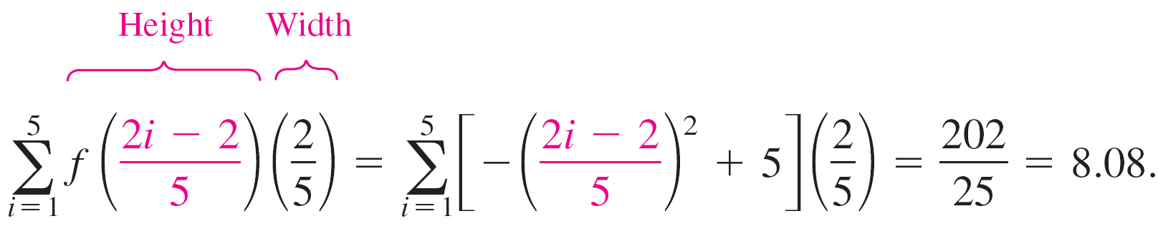
Example 3(b) – Solution
cont’d
The left endpoints of the five intervals are (i – 1), where i = 1, 2, 3, 4, 5.
The width of each rectangle is , and the height of each
rectangle can be obtained by evaluating f at the left
endpoint of each interval. So, the sum is

Slide 22
Example 3(b) – Solution
cont’d
Because the parabolic region lies within the union of the five rectangular regions, you can conclude that the area of the parabolic region is less than 8.08.
By combining the results in parts (a) and (b), you can conclude that 6.48 < (Area of region) < 8.08.

Slide 23
Upper and Lower Sums

Slide 24
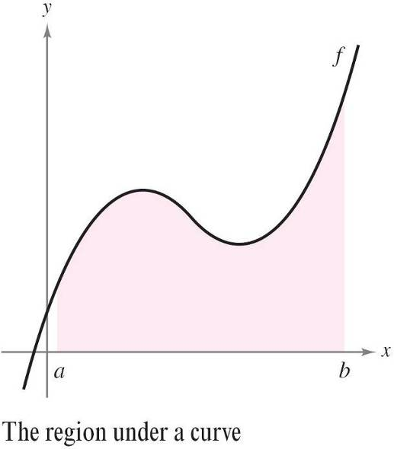
Upper and Lower Sums
Consider a plane region bounded above by the graph of a nonnegative, continuous function y = f (x), as shown in Figure 4.9.
The region is bounded below by the x-axis, and the left and right boundaries of the region are the vertical lines x = a and x = b.
Figure 4.9

Slide 25
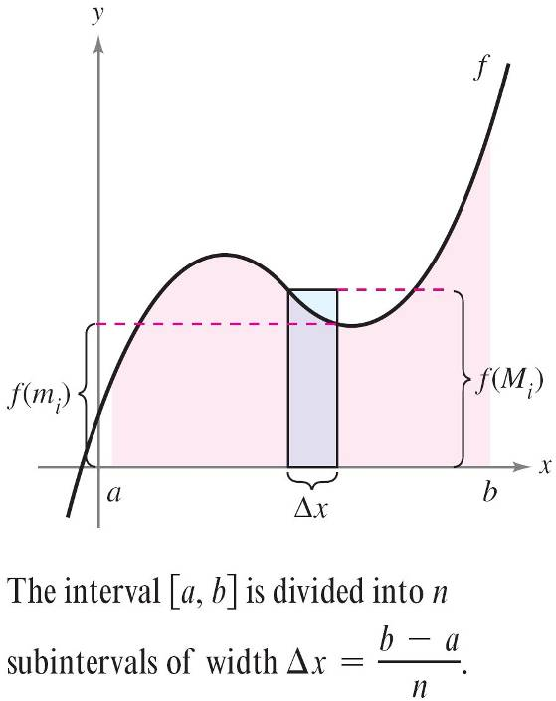
Upper and Lower Sums
To approximate the area of the region, begin by subdividing the interval [a, b] into n subintervals, each of width Δx = (b – a)/n, as shown in Figure 4.10.
Figure 4.10

Slide 26
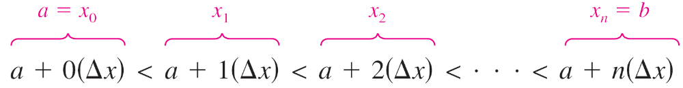
Upper and Lower Sums
The endpoints of the intervals are as follows.
Because f is continuous, the Extreme Value Theorem
guarantees the existence of a minimum and a maximum
value of f (x) in each subinterval.
f (m_{i}) = Minimum value of f (x) in ith subinterval
f (M_{i}) = Maximum value of f (x) in ith subinterval

Slide 27
Upper and Lower Sums
Next, define an inscribed rectangle lying inside the ith subregion and a circumscribed rectangle extending outside the ith subregion. The height of the ith inscribed rectangle is f(m_{i}) and the height of the ith circumscribed rectangle is f(M_{i}).
For each i, the area of the inscribed rectangle is less than or equal to the area of the circumscribed rectangle.

Slide 28
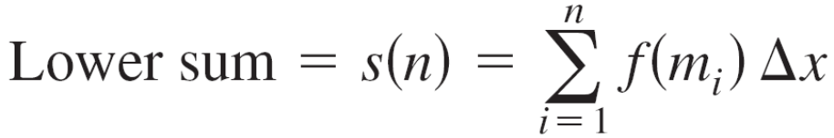

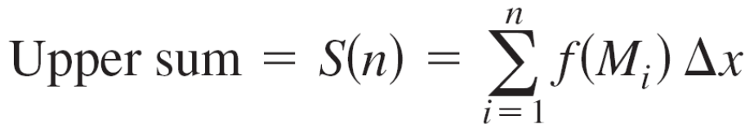
Upper and Lower Sums
The sum of the areas of the inscribed rectangles is called a lower sum, and the sum of the areas of the circumscribed rectangles is called an upper sum.

Slide 29
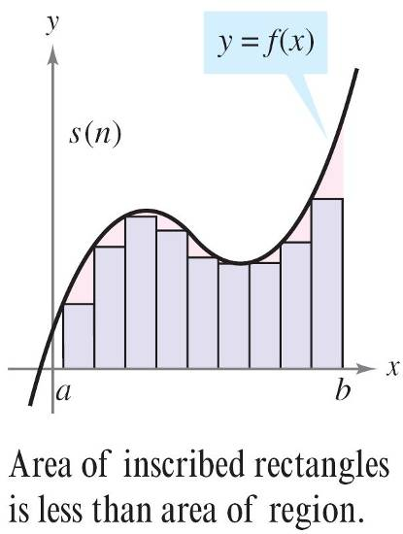
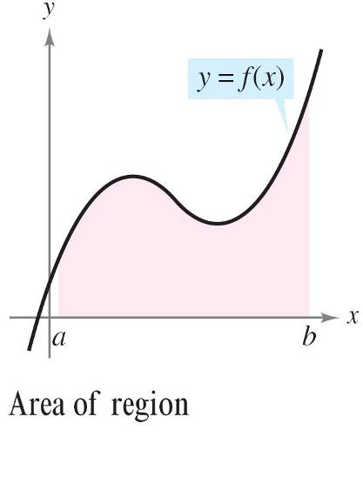
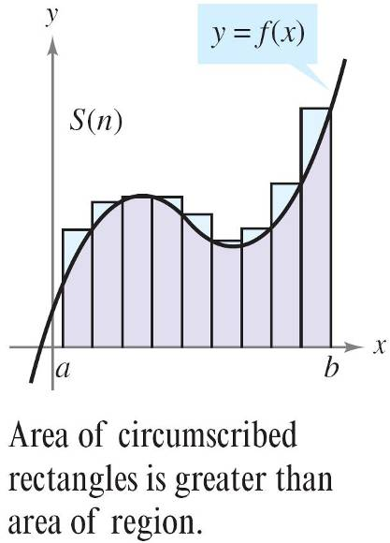
Upper and Lower Sums
From Figure 4.11, you can see that the lower sum s(n) is less than or equal to the upper sum S(n).
Moreover, the actual area of the region lies between these two sums.
Figure 4.11

Slide 30
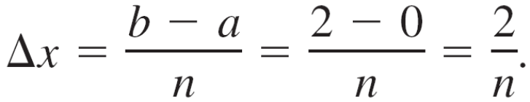
Example 4 – Finding Upper and Lower Sums for a Region
Find the upper and lower sums for the region bounded by the graph of f(x) = x² and the x-axis between x = 0 and x = 2
Solution:
To begin, partition the interval [0, 2] into n subintervals, each of width

Slide 31
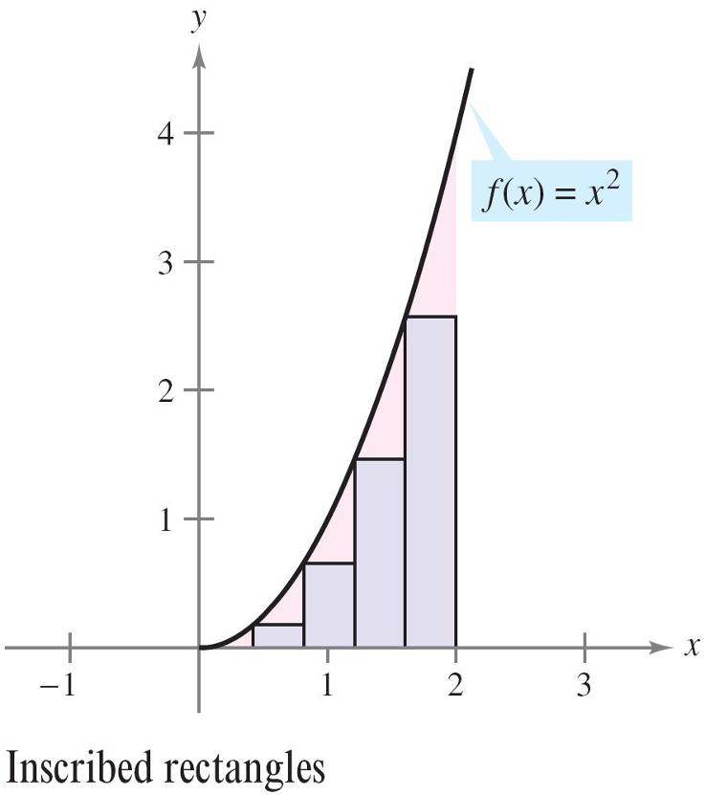
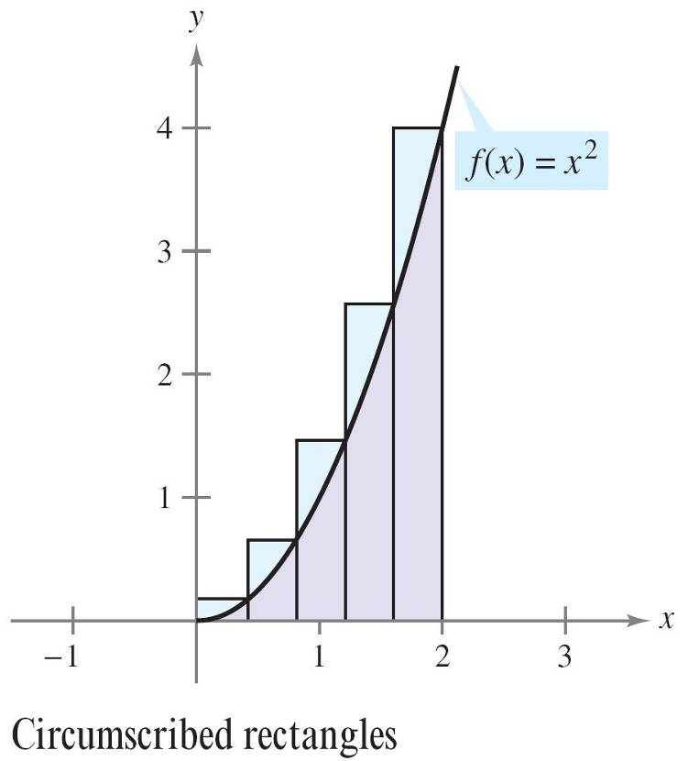
Example 4 – Solution
cont’d
Figure 4.12 shows the endpoints of the subintervals and several inscribed and circumscribed rectangles.
Figure 4.12

Slide 32
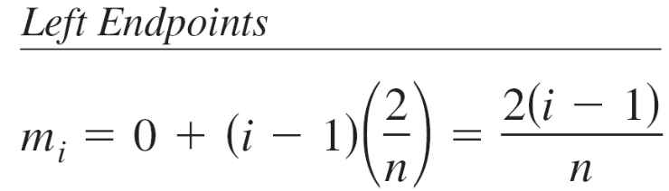
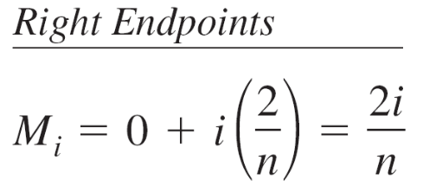
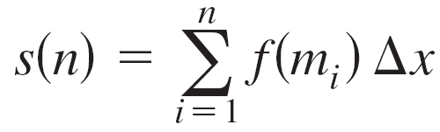
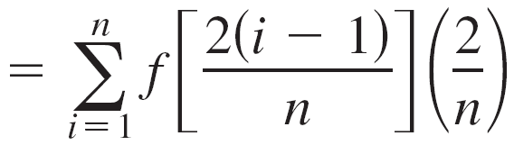
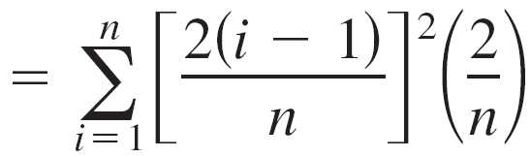
Example 4 – Solution
cont’d
Because f is increasing on the interval [0, 2], the minimum value on each subinterval occurs at the left endpoint, and the maximum value occurs at the right endpoint.
Using the left endpoints, the lower sum is

Slide 33
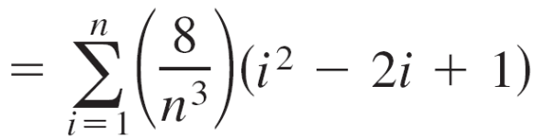
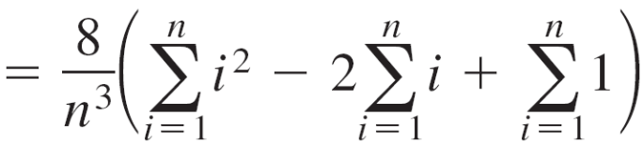
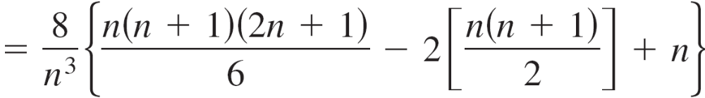
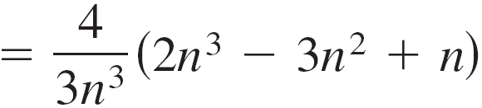
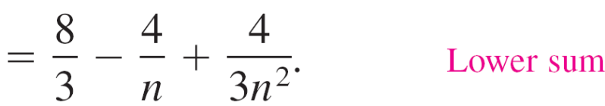
Example 4 – Solution
cont’d

Slide 34
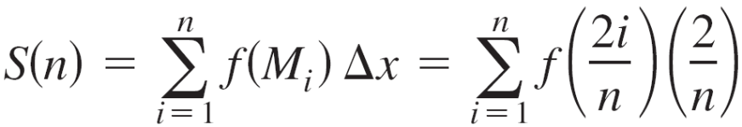
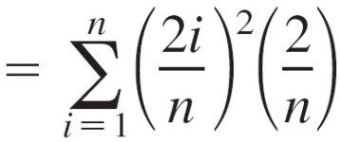
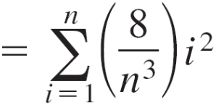
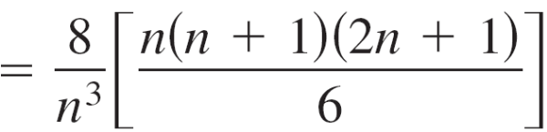
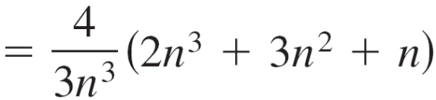
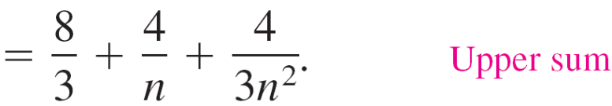
Example 4 – Solution
cont’d
Using the right endpoints, the upper sum is

Slide 35
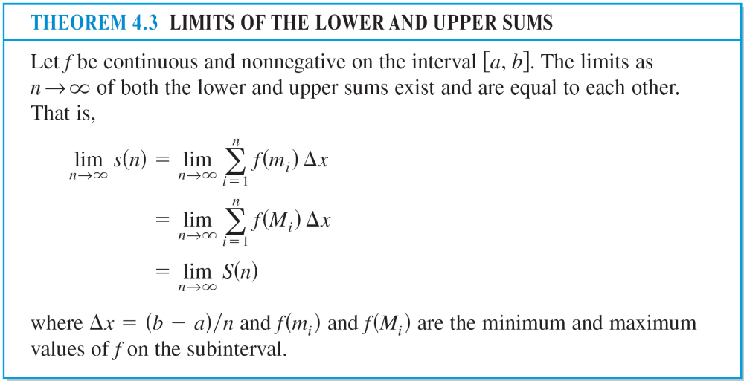
Upper and Lower Sums

Slide 36


Upper and Lower Sums
You are free to choose an arbitrary x-value in the ith subinterval, as in the following definition of the area of a region in the plane.
Figure 4.13

Slide 37

Example 5 – Finding Area by the Limit Definition
Find the area of the region bounded by the graph f(x) = x³,
the x-axis, and the vertical lines x = 0 and x = 1 as shown in Figure 4.14.
Figure 4.14

Slide 38



Example 5 – Solution
Begin by noting that f is continuous and nonnegative on the interval [0, 1]. Next, partition the interval [0, 1] into n subintervals, each of width Δx = 1/n.
According to the definition of area, you can choose any x-value in the ith subinterval.
For this example, the right endpoints c_{i} = i/n are convenient.

Slide 39





Example 5 – Solution
cont’d
The area of the region is

